Slide 1


Sailing Club

Slide 2

Tonight's Topics
  Review
  How/When to ‘Trim’ and Steer
  How Sails Work
    How to Read Them
  Introduction to Parts of the Boat
Sailing Club

Slide 3
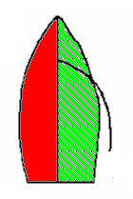
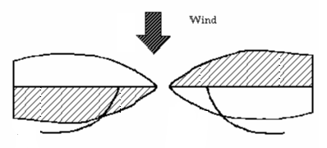
Determining the Boats ‘Tack’
  Boat can be on one of two tacks, Port or Starboard
  Based on where the wind is, not where the sail is
Port Tack
Starboard Tack
Port
Starboard
Sailing Club

Slide 4
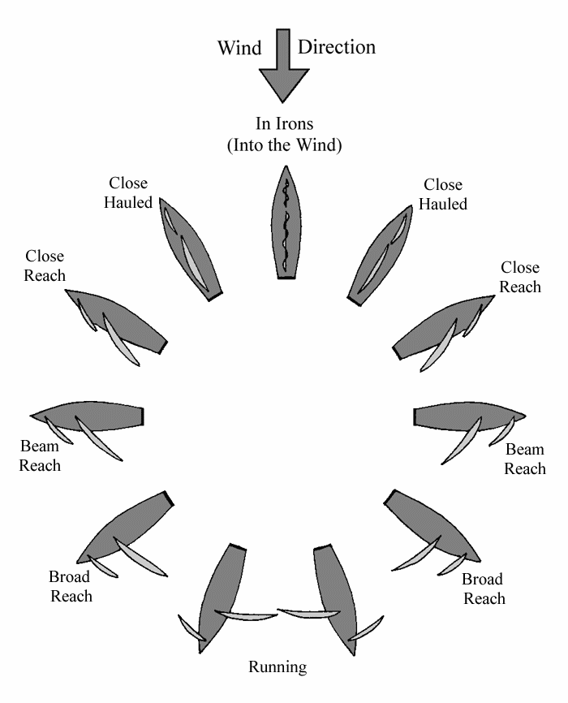
Where will/should the Sail be?
Starboard Tack
Port Tack
Sailing Club

Slide 5
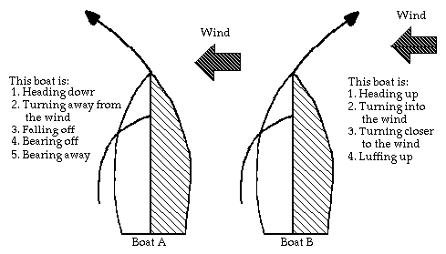
Relation Between Steering and Trimming
  Steering is independent of Trimming
  Trimming is based on wind direction which is directly dependent on Steering
Sailing Club

Slide 6
How/When does the sail changes sides?
  When changing Tacks
  When you steer through the wind: Tack (same word, yet another meaning)
  When you steer away from the wind: Jibe (Jybe or Gybe, can’t make this up)
Sailing Club

Slide 7
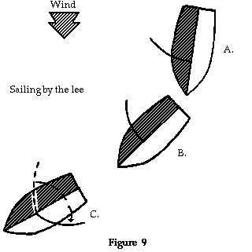
How/When does the sail changes sides?
  Jibing
  Less safe in very high breeze, Faster, Easier
Sailing Club

Slide 8
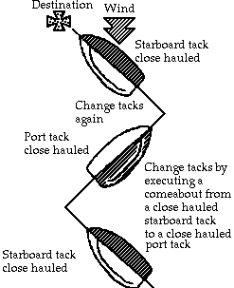
How/When does the sail changes sides?
  Tacking
  Safer (Boat passes through ‘safe zone’), Requires speed
Sailing Club

Slide 9
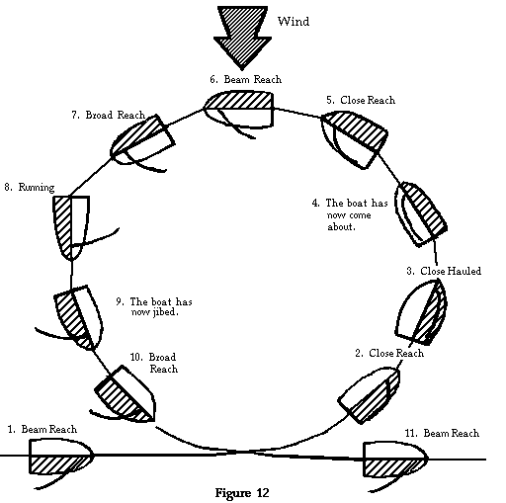
How/When does the sail changes sides?
Sailing Club

Slide 10
How/When does the sail changes sides?
  Standing Rigging
    Holds the boat and its hardware together
  Running Rigging
    Lines that control the sails
Sailing Club

Slide 11
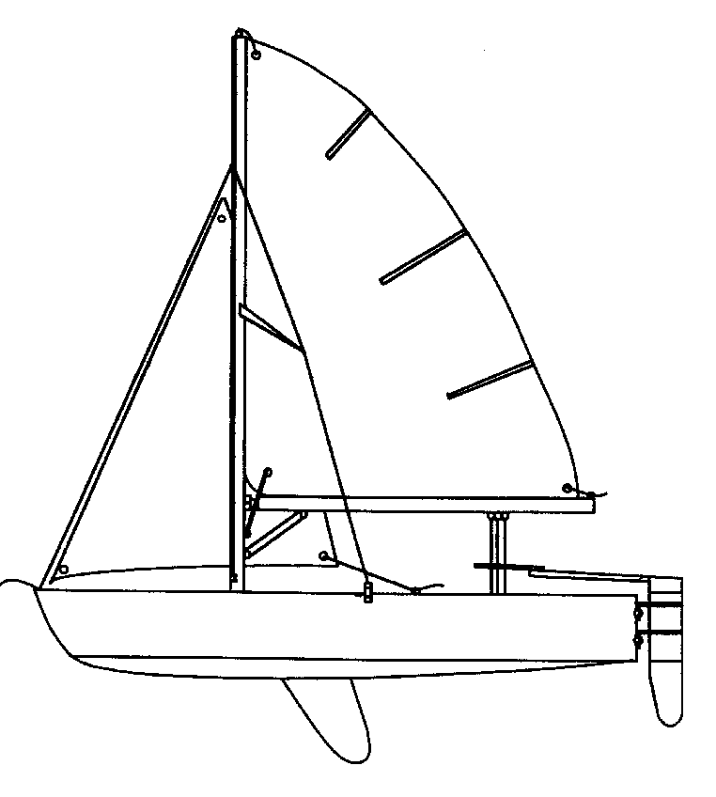
Part of the Boat-Hull
Tiller
Extension
Tiller
Bow
Stern
Gunwale
Transom
Painter
Hull
Pintles
Gudgeons
CenterBoard
(Daggerboard / Keel)
Rudder
Waterline
Sailing Club
Plug

Slide 12
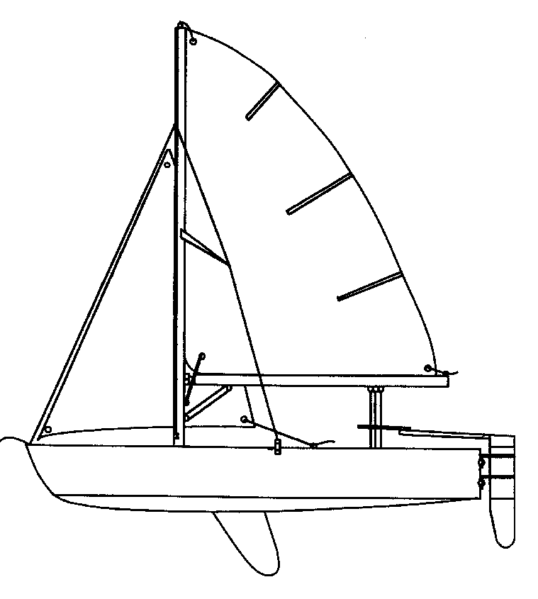
Parts of the Boat- Sails
Head
Batten
Main Sail
Jib
Luff
Leach
Foot
Tack
Clew
Telltales
Grommets
Sailing Club

Slide 13
Parts of the Boat-Rigging
Standing
Running
Mast
Halyard
Boom
Spreader
Forestay
Cunningham
Shroud
Jib Sheet
Outhaul
Gooseneck
Main Sheet
Chainplate
Boom Vang
Sailing Club

Slide 14
Questions?
  The points-of-sail terms and parts of the boat terms can be overwhelming and do not need to be memorized…yet.
  We will cover this all in even more detail this weekend, be ready for a great time!
Sailing Club

